Slide 1
Elective course:
Creative and Effective Marketing (CEM) A24

Slide 2
Course overview
What will I learn in this course?
Who will teach me?
What does the semester look like?
What am I going to read?
How are we going to do it?
What about the exam?

Slide 3
What will I learn?
“How to make and present
Creative & Effective Marketing”

Slide 4
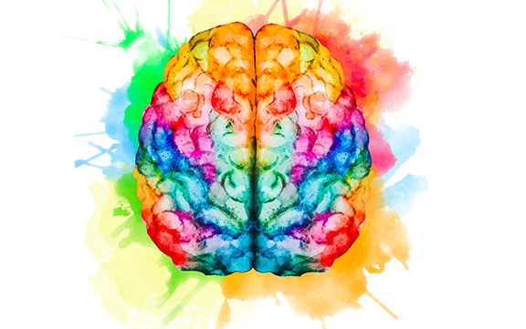
Creative marketing

Slide 5
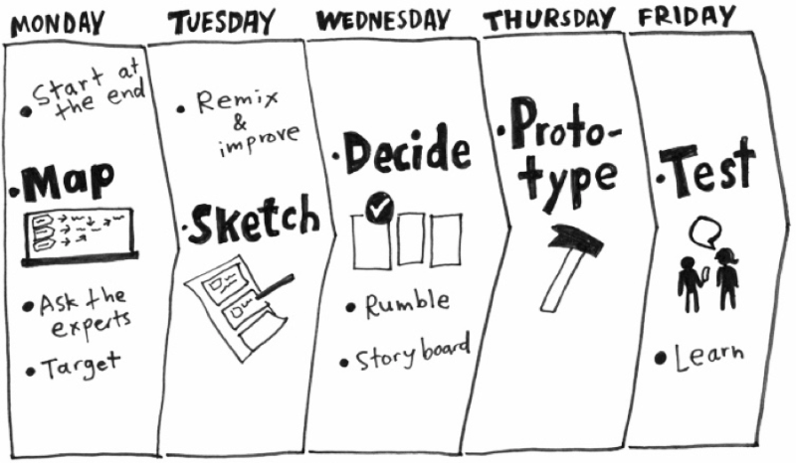
Creative marketing – central model
Creative process
https://youtu.be/K2vSQPh6MCE
Notes:
Youtube channel: youtube.com/playlist?list=PLQjb7PbWSDVZv_CEfvpK6UzC0vJhBGgGg

Slide 6
Effective marketing

Slide 7
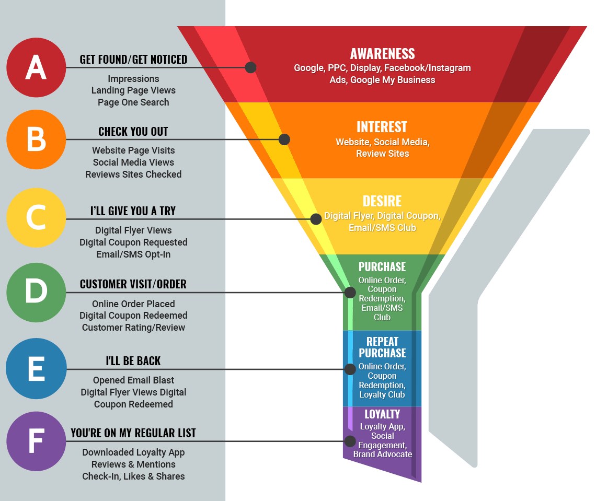
Effective marketing – central model
Funnel

Slide 8
Creative and effective marketing
Who is really good at this?
Who are the best in the world?
Who can we study, look up to and get inspired by?

Slide 9
Cannes Lions
International Festival of Creativity (World Cup of Marketing)

Slide 10
Cannes Lions
“Creative effectiveness award”
“The Creative Effectiveness Lions celebrate the measurable impact of creativity.
Work that demonstrates hard results over the long term;
that is, how the work drove tangible business effects, cultural change or achievement of brand purpose”
Lions 2022: Zelenskyy about creativity: https://vimeo.com/722190803
Notes:
https://www.canneslions.com,
https://www.lovethework.com

Slide 11
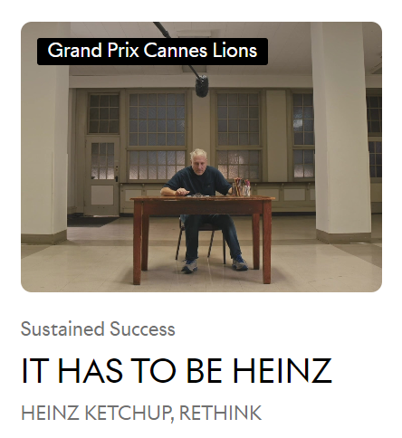

Slide 15
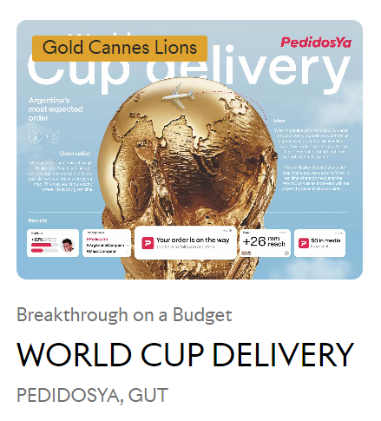

Slide 17
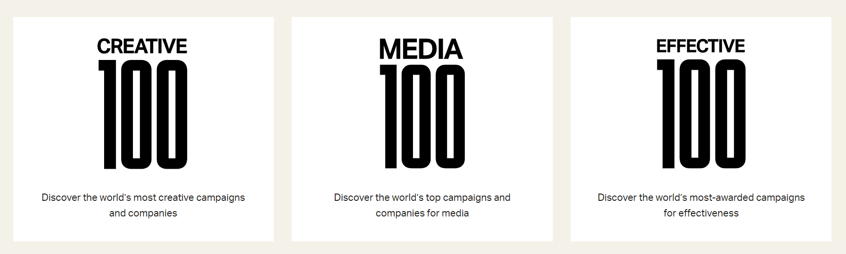
WARC 100
Ranking of the world's 100 best marketing campaigns and companies, based on performance in effectiveness and strategy competitions. https://www.warc.com/rankings
Notes:
It focuses on marketing that makes a difference, driving business performance or changing consumer behavior.
It is a benchmark for commercial creativity, allowing brands and agencies to compare their performance with their peers.
It is a showcase for the world's smartest strategies, and the people and organisations behind them.
It is a metaaward “Over 2,000 award winners in 79 competitions”

Slide 19
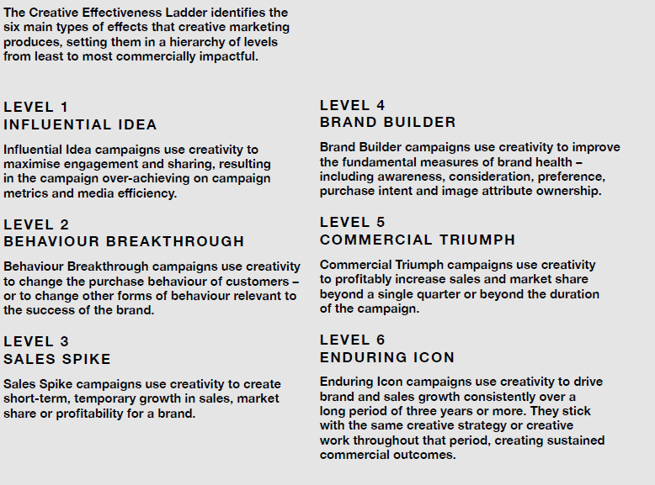

Slide 20
WHY
CEM

Slide 21
…behind CEM

Slide 22
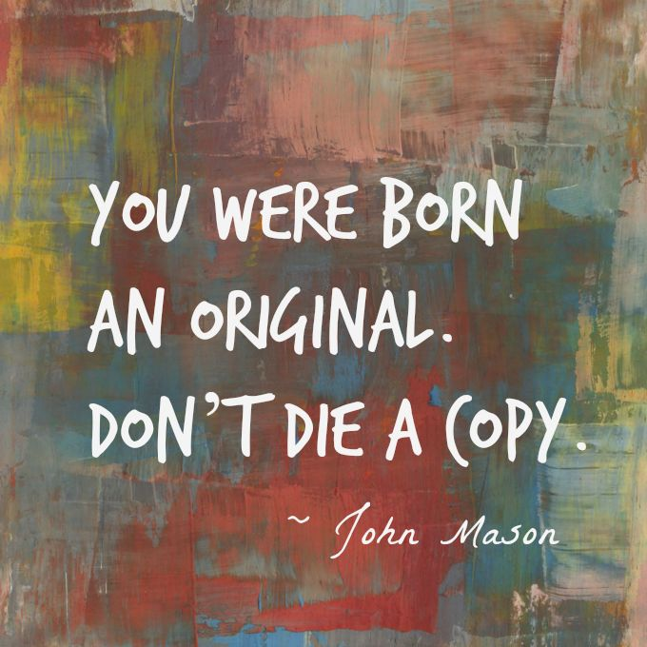

Slide 23
Restore creative confidence
Notes:
We learn that we are not and should not be creative.
We need to reverse that and build creative confidence
Believe that we are more than our grades and that
Our ideas ideas are original and valuable

Slide 24
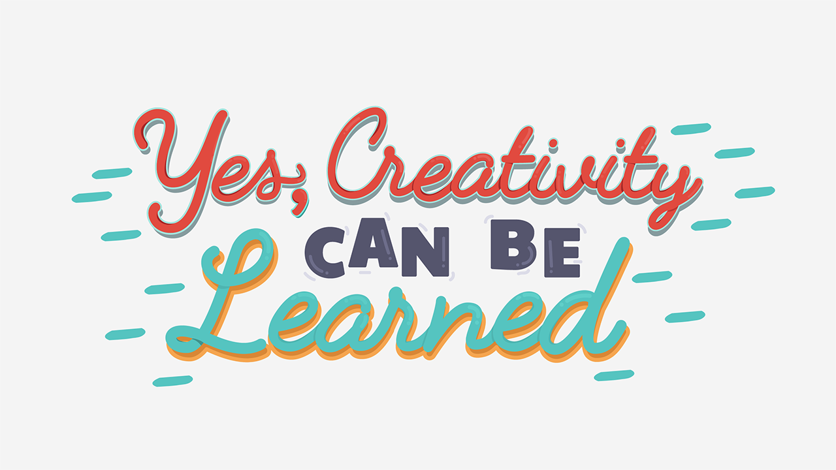

Slide 25
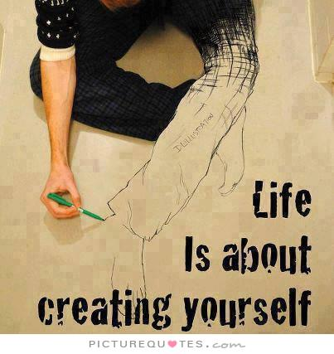
Notes:
Not just about marketing – much broader scope
Live a creative life…

Slide 26
Notes:
We also need to practice entrepreneurial skills.
In the future it is not about getting an education, getting a job and doing what you are told
It is about creating your own education, creating your own job and showing what is possible

Slide 27
Marketing is a creative industry
You solve complex problems using creative skills
Notes:
You solve complex problems using creative skills… when you create attention, interest, desire and call to action…

Slide 28
Notes:
Looking at which types of jobs that are created it looks like
Fourth industrial revolution will make many manufacturing and administrative jobs go away and new ones will be created especially in the creative industries.
In DK almost 50% of the workforce are doing creative jobs – they are part of the creative class.
Creativity has become everyones job. Not just R&D, an elite (some special creative people or consultants) or executives…
Everybody has to contribute to solving complex problems – doing innovation

Slide 29
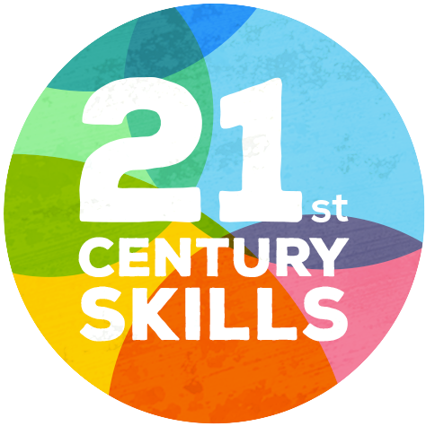
Notes:
At VIA we take on the challenge to educate and prepare young people for 21st century work life
What does the future work life look like?
Which skills do we need to focus on?

Slide 30
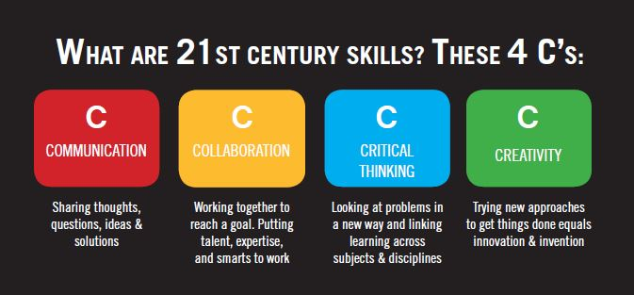

Slide 31
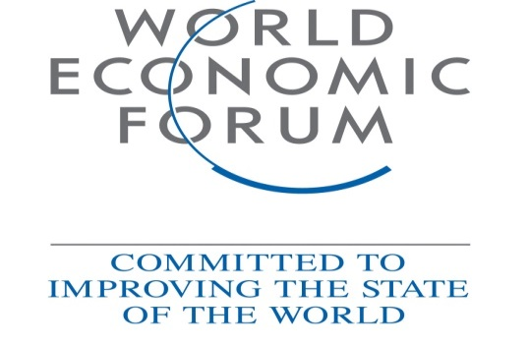
Notes:
Five years from now, over one-third of skills (35%) that are considered important in today’s workforce will have changed.
By 2020, the Fourth Industrial Revolution will have brought us advanced robotics and autonomous transport, artificial intelligence and machine learning, advanced materials, biotechnology and genomics.
These developments will transform the way we live, and the way we work. Some jobs will disappear, others will grow and jobs that don’t even exist today will become commonplace. What is certain is that the future workforce will need to align its skillset to keep pace.
A new Forum report, The Future of Jobs, looks at the employment, skills and workforce strategy for the future.
The report asked chief human resources and strategy officers from leading global employers what the current shifts mean, specifically for employment, skills and recruitment across industries and geographies.

Slide 32
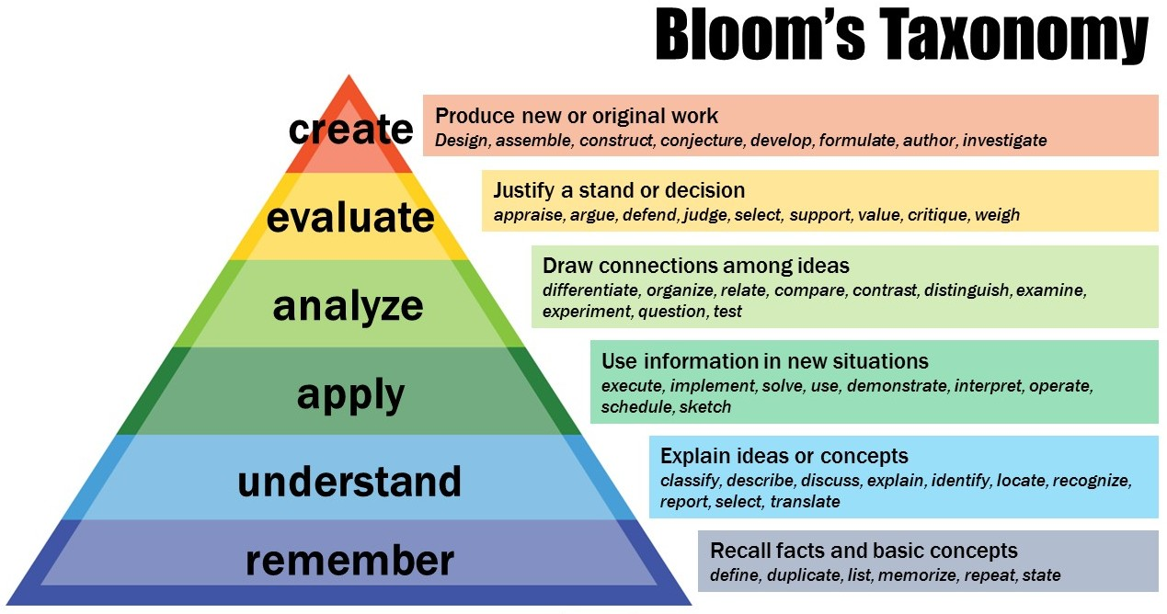
Notes:
Highest of the HOTS “higher order thinking skills…”

Slide 33
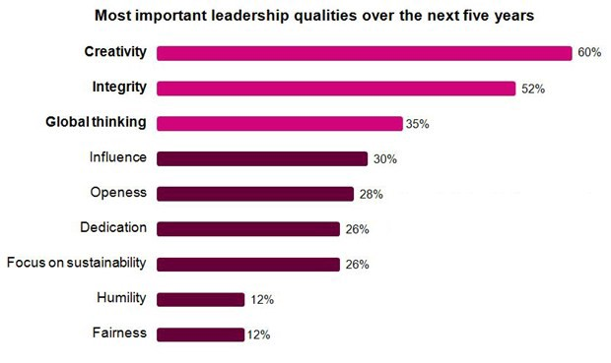
Most important leadership skills
IBM study
IBM study 2010,
1500 CEO’s from 60 countries, 33 industries
Notes:
ARMONK, NY, - 18 May 2010: According to a major new IBM (NYSE: IBM) survey of more than 1,500 Chief Executive Officers from 60 countries and 33 industries worldwide, chief executives believe that -- more than rigor, management discipline, integrity or even vision -- successfully navigating an increasing complex world will require creativity.
Conducted through in-person interviews with senior leaders and consultants from IBM’s Global Business Services division, less than half of global CEOs believe their enterprises are adequately prepared to handle a highly volatile, increasingly complex business environment. CEOs are confronted with massive shifts – new government regulations, changes in global economic power centers, accelerated industry transformation, growing volumes of data, rapidly evolving customer preferences – that, according to the study, can be overcome by instilling “creativity” throughout an organization.
More than 60 percent of CEOs believe industry transformation is the top factor contributing to uncertainty, and the finding indicates a need to discover innovative ways of managing an organization’s structure, finances, people and strategy.
The study also uncovers starkly divergent strategic concerns and priorities among CEOs in Asia, Japan, Europe or North America – the first time such clear regional variations have appeared in this biennial survey of private and public sector leaders.
"Coming out of the worst economic downturn in our professional lifetimes -- and facing a new normal that is distinctly different -- it is remarkable that CEOs identify creativity as the number one leadership competency of the successful enterprise of the future," said Frank Kern, senior vice president, IBM Global Business Services "But step back and think about it, and this is entirely consistent with the other top finding in our Study -- that the biggest challenge facing enterprises from here on will be the accelerating complexity and the velocity of a world that is operating as a massively interconnected system."
Managing complexity
The CEOs interviewed told IBM that today’s business environment is volatile, uncertain and increasingly complex. Eight in ten CEOs expect their environment to grow significantly more complex but only 49 percent believe their organizations are equipped to deal with it successfully – the largest leadership challenge identified in eight years of research.
The CEOs said that the complexity of an interconnected world is aggravated by a number of factors. For example, CEOs expect revenue from new sources to double over the next five years and 76 percent of CEOs foresee the shift of economic power to rapidly developing markets.
Over the last four studies, the expected impact of technology on organizations has risen from 6th to 2nd place in importance, revealing that CEOs understand that technology and the interconnection of the world's infrastructures is contributing to the complexity they face, and also reveals that they need more technology-based answers to succeed in a world that is massively interconnected.
The study highlights the attributes of top-performing organizations based on revenue and profit performance during the past five years, including the economic downturn.
Top performing organizations are 54 percent more likely than others to make rapid decisions. CEOs indicated they are learning to respond swiftly with new ideas to address the deep changes affecting their organizations.
95 percent of top performing organizations identified getting closer to customers as their most important strategic initiative over the next five years – using Web, interactive, and social media channels to rethink how they engage with customers and citizens. They view the historic explosion of information and global information flows as opportunities, rather than threats.
Organizations that have built superior operating dexterity expect to capture 20 percent more of their future revenue from new sources than their more traditional peers.
One World, Diverging Views
Vast complexity is further intensified by regional differences. The study noted that perspectives varied with geography – differences of opinion about what changes to make, what new skills will be needed and how to succeed in the new economic environment. These regional variations also compound the complexities with which CEOs must contend.
China proved much more resilient than the developed nations during the economic downturn. So, CEOs in China are, understandably, less concerned about volatility than CEOs in other regions. In fact, they are becoming increasingly confident of their place on the world stage.
But if China is to fulfill its global aspirations, it will need a new generation of leaders with creativity, vision and international management experience. Many of the country’s CEOs recognize this; 61 percent believe “global thinking” is a top leadership quality. Most companies will also need new industry models and skills. They cannot simply replicate the models they have used in their domestic market, which has a completely different cost structure. CEOs in China are also devoting far more energy to building new skills and capabilities than their peers in the West.
In North America, which faced a financial crisis that led to governments becoming major stakeholders in private enterprise, CEOs are more wary of “big government” than CEOs elsewhere. A full 87 percent anticipate greater government intervention and regulation over the next five years, compounding their sense of uncertainty.
In Japan, 74 percent of CEOs expect the shift of economic power from mature to rapidly developing markets to have a major impact on their organizations. By contrast, the European Union is less concerned about this shift, with only 43 percent of CEOs expecting to be impacted.
Understanding these and other sharp differences emerging by region is increasingly important as economies and societies become more closely linked. Organizations confront these differences as they increasingly operate across boundaries and across different regions.
About the IBM 2010 Global CEO Study
This study is the fourth edition of IBM’s biennial Global CEO Study series. To better understand the challenges and goals of today’s CEOs, IBM consultants met face-to-face with the largest-known sample of these executives. Between September 2009 and January 2010, IBM interviewed 1,541 CEOs, general managers, and senior public sector leaders who represent different sizes of organizations in 60 countries and 33 industries.
For access to the full study findings and case studies, please visit: http://www.ibm.com/ceostudy

Slide 34
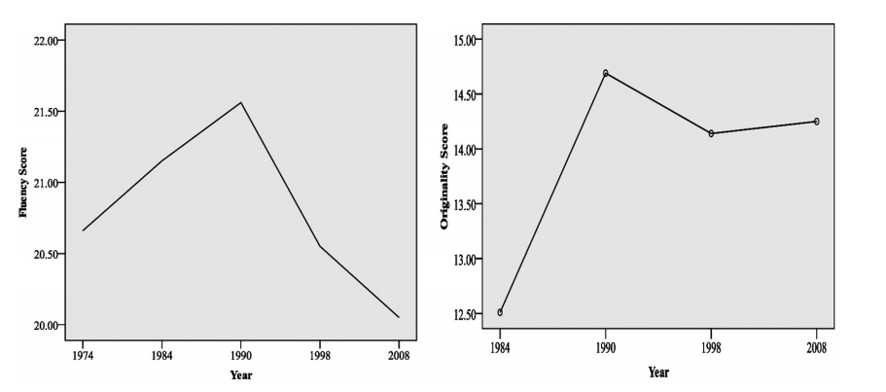
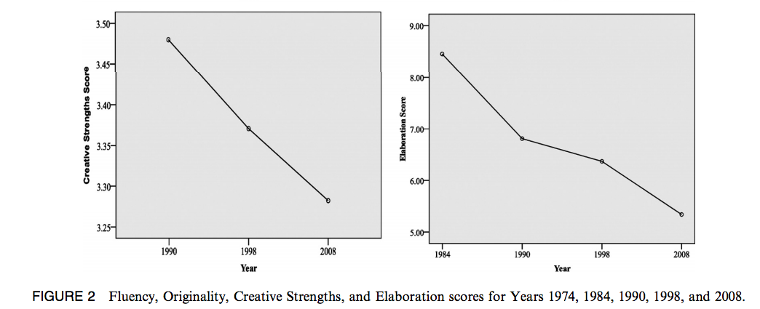
Bad news: 300,000 Torrance test scores from children and adults
Don’t worry -
that is in the US.
Notes:
From 1990 to 2008 there has been a steady decline in creativity in the US, according to research conducted by Kyung Hee Kim at the College of William & Mary. While I couldn’t find any similar South African data, a Newsweek article from 2010 suggests that it may be an America only phenomena:
Around the world, though, other countries are making creativity development a national priority
I’m not sure I buy that view? As Kim points out in a paper in the Creativity Research Journal in 2011,
Countries such as China, Japan, Korea, and Taiwan have modeled their educational systems after the American education system because of America’s previous success in encouraging creativity in children
It seems to me that one could quite easily conclude that creativity growth prospects, around the world, aren’t looking very healthy at all. And for those of you who prefer pictures…
It’s wasn’t the pictures that scared me as much as the conclusions that Kim draws from her research (included analyzing almost 300,000 Torrance scores of children and adults)…
Thus, it can be concluded younger children’s ability to produce statistically infrequent, unique, and unusual ideas has significantly decreased after 1990.
and….
The significant decrease of Strengths scores since 1990 indicates that over the last 20 years, children have become less emotionally expressive, less energetic, less talkative and verbally expressive, less humorous, less imaginative, less unconventional, less lively and passionate, less perceptive, less apt to connect seemingly irrelevant things, less synthesizing, and less likely to see things from a different angle. It could be speculated children are learning to interact in more impersonal ways, as they are more dependent on current technologies to communicate, perhaps because these technologies lack person to person, verbal and other interpersonal communicative signals. Technologies can enhance creativity and are useful tools for the creative process; however, some aspects of technologies may hinder the development of a child’s creative personality. The decrease in Elaboration scores which persists since 1984 indicates that over the last 30 years, 1) people of all ages, kindergartners through adults, have been steadily losing their ability to elaborate upon ideas and detailed and reflective thinking; 2) people are less motivated to be creative; and 3) creativity is less encouraged by home, school, and society overall.
and….
The results indicate younger children are becoming less capable of the critical thinking processes of synthesis and organization and less capable of capturing the essence of problems.
and….
The results indicate younger children are tending to grow up more narrow-minded, less intellectually curious, and less open to new experiences.
I don’t know about you, but it’s at this point I’m hoping like hell that this is just an American problem. My gut, sadly, tells me otherwise. While I don’t have any data, my own anecdotal observations quite easily match some of these conclusions in the world I inhabit. I’d be more than happy to be proved incorrect.
Does It Matter?
Of course it matters. At a macroeconomic level it counts.The health of an economy relies heavily on the creativity and innovation of scientists, engineers, business people, farmers, miners, and any person who contributes towards it, to employ more people, build more things that other countries want to buy, produce more food from the same piece of land, improve our national health, secure our borders, etc, etc. And we have to do it better than before. We can’t just do what we did last year, and the year before. We’ve got to find new and improved ways to do everything, all the time. Cheaper, better, faster and more of it.
On a microeconomic level you can take that thinking and run it through almost every single part of an economy. Provinces want all that, cities want it too, and so do businesses, and sports teams, and farmers and miners, and families and you. Even Mother Nature is hoping we’ll find better ways to treat our planet and everything that lives on it.
At a personal level it matters. Creativity breathes life into an otherwise mundane and boring existence. I don’t know if you’ve ever considered a life in which you had no access to creativity inside of yourself? A life without the skill set of creativity leaves you doing what when you get home from a day in the office where you followed instructions all day? It leaves you doing what on the weekend when you wake up on Saturday morning yearning to do something different? Well actually there’ll be no yearning. Creativity is that yearning to do something different, something unusual, something adventurous.
Here Come The Machines
I’ve always held onto the view that the one thing machines / robots will never do better than humans is ‘creativity’. When it comes to repetitive functional tasks they’re already replacing us and showing they do those jobs far better. But creativity, I don’t think so. That’s our domain. It’s what makes us human. The ability to not only desire to find another way, but to also take disconnected bits and pieces, and thoughts and ideas and put them together in a way that changes the world. I often say to my peer group of parents, don’t let your children study anything a machine might be able to replace, because a machine will replace it. Encourage your children to pick something, anything, that has an element of creativity at it’s centre and they’ll never have to complete with a machine or a robot. Not ever.
But if we’re going to let our creativity levels slide into the toilet, it’s not going to be a case of machines catching up to our creativity level, we’re just gonna hand it over to them on a plate, as we slide on by, towards a world of grey (no shades, just grey).
The Magic That Is Creativity
We’ve become so fixated on getting smarter in our heads, that we’ve missed the magic that is creativity. Do any Google search on ‘Einstein quotes’ (I’ll make it easy for you) and you’ll see him speaking of imagination and creativity over and over again. Academic genius without creativity and imagination is nothing. It’s a machine. It’s a robot. Robots have that kind of smarts. They know lots of things in one dimension. They can apply those things in that one dimension faster than any human. Creativity and imagination unlock the potential of knowledge, because if you can’t apply knowledge it’s not worth having.
It was at 16, while Einstein was imagining what it would be like to ride next to a beam of light that the first thoughts of what was to become the Theory of Relativity was born. He was imagining long before he had the brainpower to solve the question he was asking.
I can’t say if this slide in creativity is happening here in South Africa or not? I can say, that if it is we need to do more than just pay attention. We need to stop the slide, turn it around and send it on it’s way into space where our children, all of them, have imagination power to think about things like riding next to light beams, and then we can be assured that all this academic information we’re feeding them will be put to great use, and maybe even change the world.

Slide 35
CEM
MISSION
VISION
VALUES

Slide 36
CEM MISSION
“why this elective exists and why I care”
We develop our:
“creative competence”
&
“creative confidence”
So we can make:
“creative and effective marketing”
&
live a creative life.

Slide 37
CEM VISION
“what we work hard at every day”
To be:
Attractive “creatives”
Known for our “creative and effective marketing campaigns”.
We have:
Demonstrated our abilities through the work we have done for our clients.

Slide 38
CEM VALUES
“how we do things around here”
We are curious and open to the world
We value our differences as a key to creativity
We look for and appreciate feedback
We fight fear with creative confidence
we trust in our ability to create and achieve what we set out to do

Slide 39
What will I learn?
Semester plan on ITL

Slide 40
Study 3 questions
Question 1:
What is creativity and creative marketing?
Question 2:
What does your creative process look like?
Question 3:
What is effective marketing?

Slide 41
Work for client
Client:
One of Bubble’s real clients

Slide 42
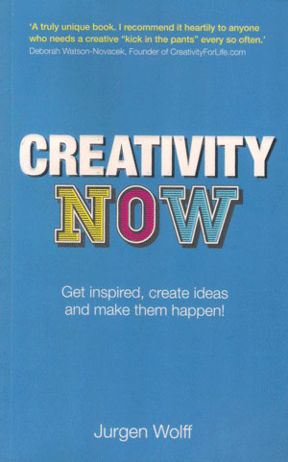
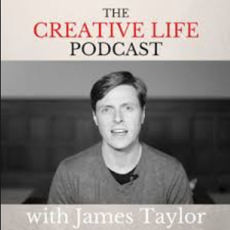
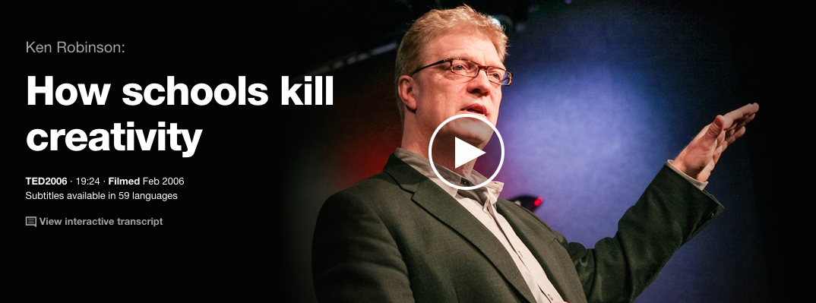
What should I read?
Mix of books, articles, podcasts, videos, ted talks, tutorials…
You will put together your own curriculum based on your preferred ”academic” literature.

Slide 43
Literature list
You must make a literature list.
Preferably on your portfolio.
How much is enough?
You need to answer the three guiding questions in depth and have sources.
You should be able to explain what you put on your literature list
Don’t put the whole book if it is only chapter 3

Slide 44
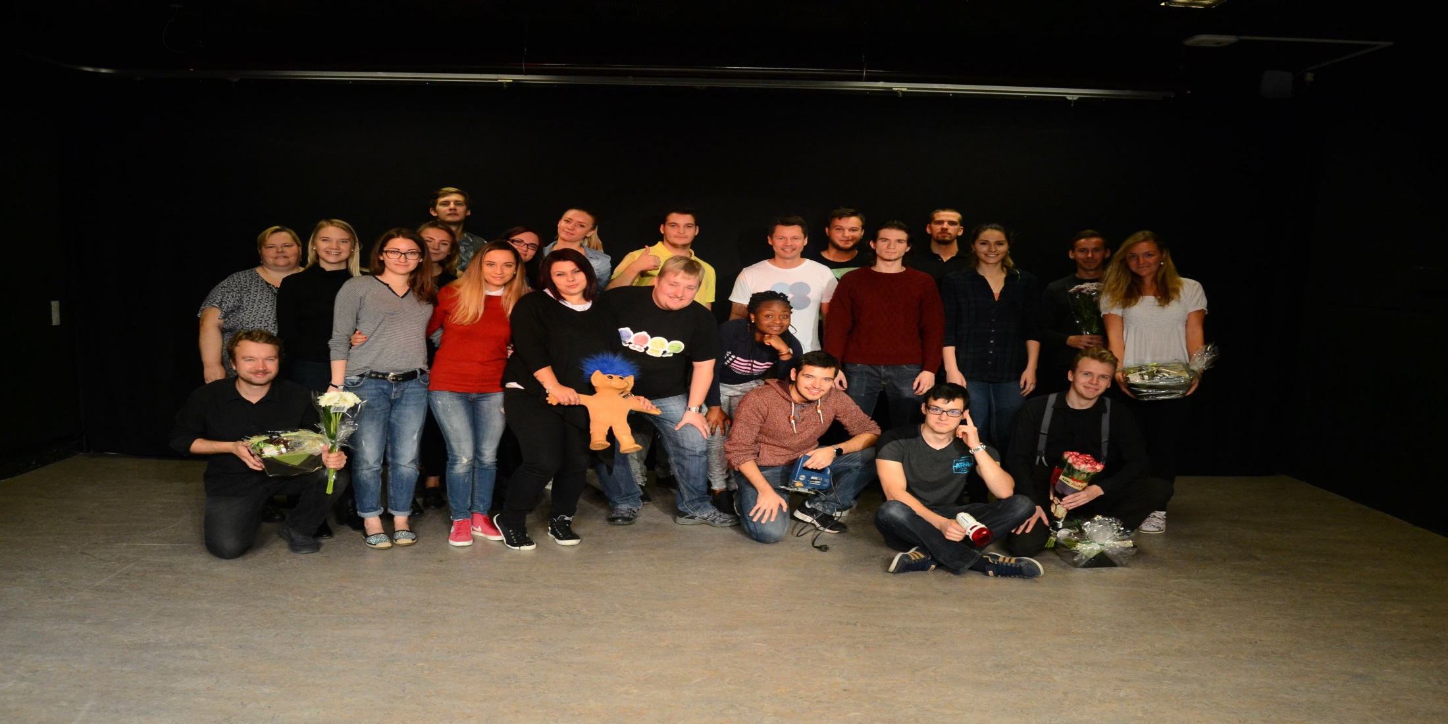
Improvisation & presentation lesson

Slide 45
Drawing lessons
Visualize your ideas… everybody can do it!

Slide 46
Prototyping (practical work)
Advertisment
Website
Videos
Posters
Radio
Animations
Fair
Event
Guerilla
Direct
Fee: 200 kr.

Slide 47
What is the exam like?
The examination is an individual oral examination.
Hand in before the exam
(must be handed in in order to participate in the exam):
Individual reflections on learning outcome during the course. Maximum 4,800 characters.
Digital portfolio (website) of a) your presentations and b) the creative products you have made during the semester
Individual curriculum – list of sources used throughout the semester
Oral examination (20 min.)
5 min. individual presentation
10 min. examination. Examination is based on what you hand in and your presentation.
The examination is done by 2 internal examiners.
Dates: 2 December – 5 December

Slide 48
Presentations
Presentations (week 41, 46 and 48) will be recorded and given to the group as ”feedback”.
Please reflect.

Slide 50
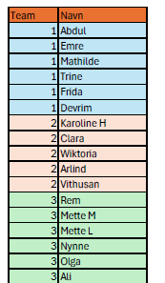
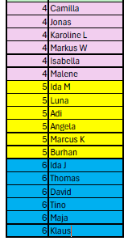
Group organization

Slide 51
DOES CREATIVITY MATTER?

Slide 52
Notes:
From 1990 to 2008 there has been a steady decline in creativity in the US, according to research conducted by Kyung Hee Kim at the College of William & Mary. While I couldn’t find any similar South African data, a Newsweek article from 2010 suggests that it may be an America only phenomena:
Around the world, though, other countries are making creativity development a national priority
I’m not sure I buy that view? As Kim points out in a paper in the Creativity Research Journal in 2011,
Countries such as China, Japan, Korea, and Taiwan have modeled their educational systems after the American education system because of America’s previous success in encouraging creativity in children
It seems to me that one could quite easily conclude that creativity growth prospects, around the world, aren’t looking very healthy at all. And for those of you who prefer pictures…
It’s wasn’t the pictures that scared me as much as the conclusions that Kim draws from her research (included analyzing almost 300,000 Torrance scores of children and adults)…
Thus, it can be concluded younger children’s ability to produce statistically infrequent, unique, and unusual ideas has significantly decreased after 1990.
and….
The significant decrease of Strengths scores since 1990 indicates that over the last 20 years, children have become less emotionally expressive, less energetic, less talkative and verbally expressive, less humorous, less imaginative, less unconventional, less lively and passionate, less perceptive, less apt to connect seemingly irrelevant things, less synthesizing, and less likely to see things from a different angle. It could be speculated children are learning to interact in more impersonal ways, as they are more dependent on current technologies to communicate, perhaps because these technologies lack person to person, verbal and other interpersonal communicative signals. Technologies can enhance creativity and are useful tools for the creative process; however, some aspects of technologies may hinder the development of a child’s creative personality. The decrease in Elaboration scores which persists since 1984 indicates that over the last 30 years, 1) people of all ages, kindergartners through adults, have been steadily losing their ability to elaborate upon ideas and detailed and reflective thinking; 2) people are less motivated to be creative; and 3) creativity is less encouraged by home, school, and society overall.
and….
The results indicate younger children are becoming less capable of the critical thinking processes of synthesis and organization and less capable of capturing the essence of problems.
and….
The results indicate younger children are tending to grow up more narrow-minded, less intellectually curious, and less open to new experiences.
I don’t know about you, but it’s at this point I’m hoping like hell that this is just an American problem. My gut, sadly, tells me otherwise. While I don’t have any data, my own anecdotal observations quite easily match some of these conclusions in the world I inhabit. I’d be more than happy to be proved incorrect.
Does It Matter?
Of course it matters. At a macroeconomic level it counts.The health of an economy relies heavily on the creativity and innovation of scientists, engineers, business people, farmers, miners, and any person who contributes towards it, to employ more people, build more things that other countries want to buy, produce more food from the same piece of land, improve our national health, secure our borders, etc, etc. And we have to do it better than before. We can’t just do what we did last year, and the year before. We’ve got to find new and improved ways to do everything, all the time. Cheaper, better, faster and more of it.
On a microeconomic level you can take that thinking and run it through almost every single part of an economy. Provinces want all that, cities want it too, and so do businesses, and sports teams, and farmers and miners, and families and you. Even Mother Nature is hoping we’ll find better ways to treat our planet and everything that lives on it.
At a personal level it matters. Creativity breathes life into an otherwise mundane and boring existence. I don’t know if you’ve ever considered a life in which you had no access to creativity inside of yourself? A life without the skill set of creativity leaves you doing what when you get home from a day in the office where you followed instructions all day? It leaves you doing what on the weekend when you wake up on Saturday morning yearning to do something different? Well actually there’ll be no yearning. Creativity is that yearning to do something different, something unusual, something adventurous.
Here Come The Machines
I’ve always held onto the view that the one thing machines / robots will never do better than humans is ‘creativity’. When it comes to repetitive functional tasks they’re already replacing us and showing they do those jobs far better. But creativity, I don’t think so. That’s our domain. It’s what makes us human. The ability to not only desire to find another way, but to also take disconnected bits and pieces, and thoughts and ideas and put them together in a way that changes the world. I often say to my peer group of parents, don’t let your children study anything a machine might be able to replace, because a machine will replace it. Encourage your children to pick something, anything, that has an element of creativity at it’s centre and they’ll never have to complete with a machine or a robot. Not ever.
But if we’re going to let our creativity levels slide into the toilet, it’s not going to be a case of machines catching up to our creativity level, we’re just gonna hand it over to them on a plate, as we slide on by, towards a world of grey (no shades, just grey).
The Magic That Is Creativity
We’ve become so fixated on getting smarter in our heads, that we’ve missed the magic that is creativity. Do any Google search on ‘Einstein quotes’ (I’ll make it easy for you) and you’ll see him speaking of imagination and creativity over and over again. Academic genius without creativity and imagination is nothing. It’s a machine. It’s a robot. Robots have that kind of smarts. They know lots of things in one dimension. They can apply those things in that one dimension faster than any human. Creativity and imagination unlock the potential of knowledge, because if you can’t apply knowledge it’s not worth having.
It was at 16, while Einstein was imagining what it would be like to ride next to a beam of light that the first thoughts of what was to become the Theory of Relativity was born. He was imagining long before he had the brainpower to solve the question he was asking.
I can’t say if this slide in creativity is happening here in South Africa or not? I can say, that if it is we need to do more than just pay attention. We need to stop the slide, turn it around and send it on it’s way into space where our children, all of them, have imagination power to think about things like riding next to light beams, and then we can be assured that all this academic information we’re feeding them will be put to great use, and maybe even change the world.

Slide 53
Notes:
From 1990 to 2008 there has been a steady decline in creativity in the US, according to research conducted by Kyung Hee Kim at the College of William & Mary. While I couldn’t find any similar South African data, a Newsweek article from 2010 suggests that it may be an America only phenomena:
Around the world, though, other countries are making creativity development a national priority
I’m not sure I buy that view? As Kim points out in a paper in the Creativity Research Journal in 2011,
Countries such as China, Japan, Korea, and Taiwan have modeled their educational systems after the American education system because of America’s previous success in encouraging creativity in children
It seems to me that one could quite easily conclude that creativity growth prospects, around the world, aren’t looking very healthy at all. And for those of you who prefer pictures…
It’s wasn’t the pictures that scared me as much as the conclusions that Kim draws from her research (included analyzing almost 300,000 Torrance scores of children and adults)…
Thus, it can be concluded younger children’s ability to produce statistically infrequent, unique, and unusual ideas has significantly decreased after 1990.
and….
The significant decrease of Strengths scores since 1990 indicates that over the last 20 years, children have become less emotionally expressive, less energetic, less talkative and verbally expressive, less humorous, less imaginative, less unconventional, less lively and passionate, less perceptive, less apt to connect seemingly irrelevant things, less synthesizing, and less likely to see things from a different angle. It could be speculated children are learning to interact in more impersonal ways, as they are more dependent on current technologies to communicate, perhaps because these technologies lack person to person, verbal and other interpersonal communicative signals. Technologies can enhance creativity and are useful tools for the creative process; however, some aspects of technologies may hinder the development of a child’s creative personality. The decrease in Elaboration scores which persists since 1984 indicates that over the last 30 years, 1) people of all ages, kindergartners through adults, have been steadily losing their ability to elaborate upon ideas and detailed and reflective thinking; 2) people are less motivated to be creative; and 3) creativity is less encouraged by home, school, and society overall.
and….
The results indicate younger children are becoming less capable of the critical thinking processes of synthesis and organization and less capable of capturing the essence of problems.
and….
The results indicate younger children are tending to grow up more narrow-minded, less intellectually curious, and less open to new experiences.
I don’t know about you, but it’s at this point I’m hoping like hell that this is just an American problem. My gut, sadly, tells me otherwise. While I don’t have any data, my own anecdotal observations quite easily match some of these conclusions in the world I inhabit. I’d be more than happy to be proved incorrect.
Does It Matter?
Of course it matters. At a macroeconomic level it counts.The health of an economy relies heavily on the creativity and innovation of scientists, engineers, business people, farmers, miners, and any person who contributes towards it, to employ more people, build more things that other countries want to buy, produce more food from the same piece of land, improve our national health, secure our borders, etc, etc. And we have to do it better than before. We can’t just do what we did last year, and the year before. We’ve got to find new and improved ways to do everything, all the time. Cheaper, better, faster and more of it.
On a microeconomic level you can take that thinking and run it through almost every single part of an economy. Provinces want all that, cities want it too, and so do businesses, and sports teams, and farmers and miners, and families and you. Even Mother Nature is hoping we’ll find better ways to treat our planet and everything that lives on it.
At a personal level it matters. Creativity breathes life into an otherwise mundane and boring existence. I don’t know if you’ve ever considered a life in which you had no access to creativity inside of yourself? A life without the skill set of creativity leaves you doing what when you get home from a day in the office where you followed instructions all day? It leaves you doing what on the weekend when you wake up on Saturday morning yearning to do something different? Well actually there’ll be no yearning. Creativity is that yearning to do something different, something unusual, something adventurous.
Here Come The Machines
I’ve always held onto the view that the one thing machines / robots will never do better than humans is ‘creativity’. When it comes to repetitive functional tasks they’re already replacing us and showing they do those jobs far better. But creativity, I don’t think so. That’s our domain. It’s what makes us human. The ability to not only desire to find another way, but to also take disconnected bits and pieces, and thoughts and ideas and put them together in a way that changes the world. I often say to my peer group of parents, don’t let your children study anything a machine might be able to replace, because a machine will replace it. Encourage your children to pick something, anything, that has an element of creativity at it’s centre and they’ll never have to complete with a machine or a robot. Not ever.
But if we’re going to let our creativity levels slide into the toilet, it’s not going to be a case of machines catching up to our creativity level, we’re just gonna hand it over to them on a plate, as we slide on by, towards a world of grey (no shades, just grey).
The Magic That Is Creativity
We’ve become so fixated on getting smarter in our heads, that we’ve missed the magic that is creativity. Do any Google search on ‘Einstein quotes’ (I’ll make it easy for you) and you’ll see him speaking of imagination and creativity over and over again. Academic genius without creativity and imagination is nothing. It’s a machine. It’s a robot. Robots have that kind of smarts. They know lots of things in one dimension. They can apply those things in that one dimension faster than any human. Creativity and imagination unlock the potential of knowledge, because if you can’t apply knowledge it’s not worth having.
It was at 16, while Einstein was imagining what it would be like to ride next to a beam of light that the first thoughts of what was to become the Theory of Relativity was born. He was imagining long before he had the brainpower to solve the question he was asking.
I can’t say if this slide in creativity is happening here in South Africa or not? I can say, that if it is we need to do more than just pay attention. We need to stop the slide, turn it around and send it on it’s way into space where our children, all of them, have imagination power to think about things like riding next to light beams, and then we can be assured that all this academic information we’re feeding them will be put to great use, and maybe even change the world.

Slide 54
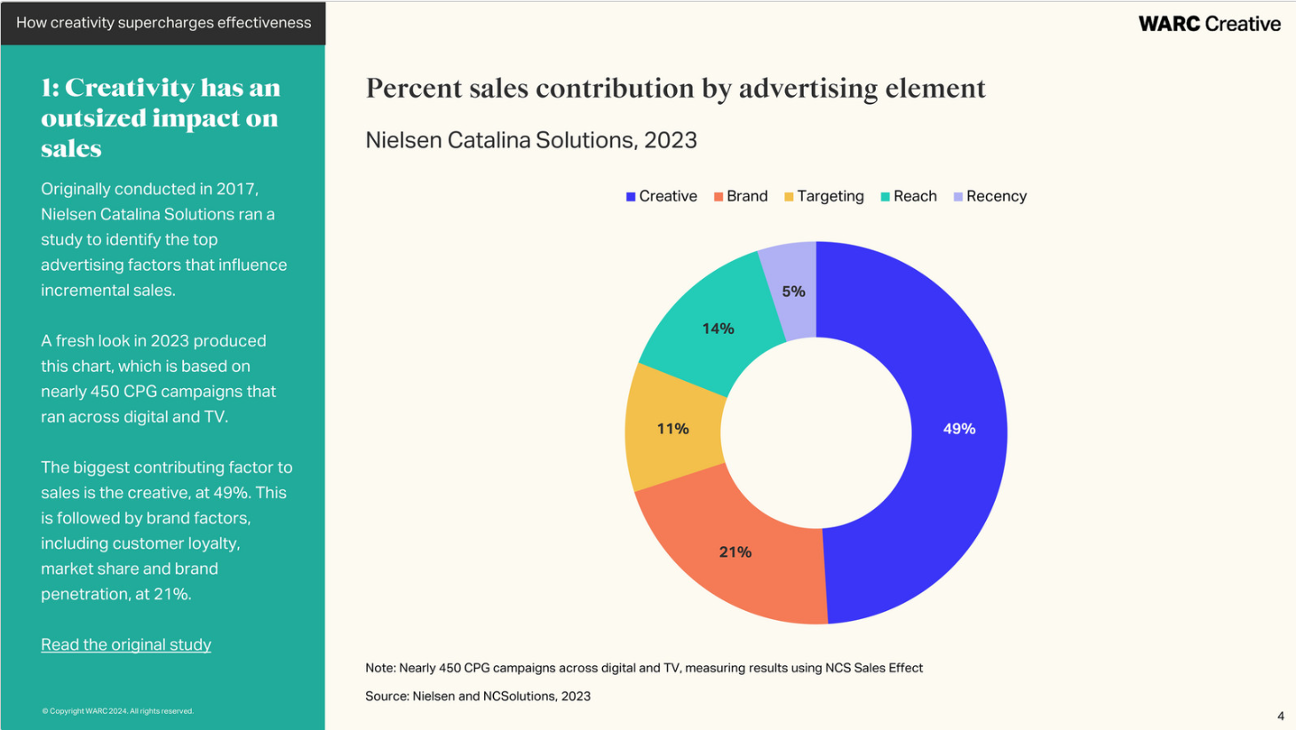
Notes:
From 1990 to 2008 there has been a steady decline in creativity in the US, according to research conducted by Kyung Hee Kim at the College of William & Mary. While I couldn’t find any similar South African data, a Newsweek article from 2010 suggests that it may be an America only phenomena:
Around the world, though, other countries are making creativity development a national priority
I’m not sure I buy that view? As Kim points out in a paper in the Creativity Research Journal in 2011,
Countries such as China, Japan, Korea, and Taiwan have modeled their educational systems after the American education system because of America’s previous success in encouraging creativity in children
It seems to me that one could quite easily conclude that creativity growth prospects, around the world, aren’t looking very healthy at all. And for those of you who prefer pictures…
It’s wasn’t the pictures that scared me as much as the conclusions that Kim draws from her research (included analyzing almost 300,000 Torrance scores of children and adults)…
Thus, it can be concluded younger children’s ability to produce statistically infrequent, unique, and unusual ideas has significantly decreased after 1990.
and….
The significant decrease of Strengths scores since 1990 indicates that over the last 20 years, children have become less emotionally expressive, less energetic, less talkative and verbally expressive, less humorous, less imaginative, less unconventional, less lively and passionate, less perceptive, less apt to connect seemingly irrelevant things, less synthesizing, and less likely to see things from a different angle. It could be speculated children are learning to interact in more impersonal ways, as they are more dependent on current technologies to communicate, perhaps because these technologies lack person to person, verbal and other interpersonal communicative signals. Technologies can enhance creativity and are useful tools for the creative process; however, some aspects of technologies may hinder the development of a child’s creative personality. The decrease in Elaboration scores which persists since 1984 indicates that over the last 30 years, 1) people of all ages, kindergartners through adults, have been steadily losing their ability to elaborate upon ideas and detailed and reflective thinking; 2) people are less motivated to be creative; and 3) creativity is less encouraged by home, school, and society overall.
and….
The results indicate younger children are becoming less capable of the critical thinking processes of synthesis and organization and less capable of capturing the essence of problems.
and….
The results indicate younger children are tending to grow up more narrow-minded, less intellectually curious, and less open to new experiences.
I don’t know about you, but it’s at this point I’m hoping like hell that this is just an American problem. My gut, sadly, tells me otherwise. While I don’t have any data, my own anecdotal observations quite easily match some of these conclusions in the world I inhabit. I’d be more than happy to be proved incorrect.
Does It Matter?
Of course it matters. At a macroeconomic level it counts.The health of an economy relies heavily on the creativity and innovation of scientists, engineers, business people, farmers, miners, and any person who contributes towards it, to employ more people, build more things that other countries want to buy, produce more food from the same piece of land, improve our national health, secure our borders, etc, etc. And we have to do it better than before. We can’t just do what we did last year, and the year before. We’ve got to find new and improved ways to do everything, all the time. Cheaper, better, faster and more of it.
On a microeconomic level you can take that thinking and run it through almost every single part of an economy. Provinces want all that, cities want it too, and so do businesses, and sports teams, and farmers and miners, and families and you. Even Mother Nature is hoping we’ll find better ways to treat our planet and everything that lives on it.
At a personal level it matters. Creativity breathes life into an otherwise mundane and boring existence. I don’t know if you’ve ever considered a life in which you had no access to creativity inside of yourself? A life without the skill set of creativity leaves you doing what when you get home from a day in the office where you followed instructions all day? It leaves you doing what on the weekend when you wake up on Saturday morning yearning to do something different? Well actually there’ll be no yearning. Creativity is that yearning to do something different, something unusual, something adventurous.
Here Come The Machines
I’ve always held onto the view that the one thing machines / robots will never do better than humans is ‘creativity’. When it comes to repetitive functional tasks they’re already replacing us and showing they do those jobs far better. But creativity, I don’t think so. That’s our domain. It’s what makes us human. The ability to not only desire to find another way, but to also take disconnected bits and pieces, and thoughts and ideas and put them together in a way that changes the world. I often say to my peer group of parents, don’t let your children study anything a machine might be able to replace, because a machine will replace it. Encourage your children to pick something, anything, that has an element of creativity at it’s centre and they’ll never have to complete with a machine or a robot. Not ever.
But if we’re going to let our creativity levels slide into the toilet, it’s not going to be a case of machines catching up to our creativity level, we’re just gonna hand it over to them on a plate, as we slide on by, towards a world of grey (no shades, just grey).
The Magic That Is Creativity
We’ve become so fixated on getting smarter in our heads, that we’ve missed the magic that is creativity. Do any Google search on ‘Einstein quotes’ (I’ll make it easy for you) and you’ll see him speaking of imagination and creativity over and over again. Academic genius without creativity and imagination is nothing. It’s a machine. It’s a robot. Robots have that kind of smarts. They know lots of things in one dimension. They can apply those things in that one dimension faster than any human. Creativity and imagination unlock the potential of knowledge, because if you can’t apply knowledge it’s not worth having.
It was at 16, while Einstein was imagining what it would be like to ride next to a beam of light that the first thoughts of what was to become the Theory of Relativity was born. He was imagining long before he had the brainpower to solve the question he was asking.
I can’t say if this slide in creativity is happening here in South Africa or not? I can say, that if it is we need to do more than just pay attention. We need to stop the slide, turn it around and send it on it’s way into space where our children, all of them, have imagination power to think about things like riding next to light beams, and then we can be assured that all this academic information we’re feeding them will be put to great use, and maybe even change the world.

Slide 55
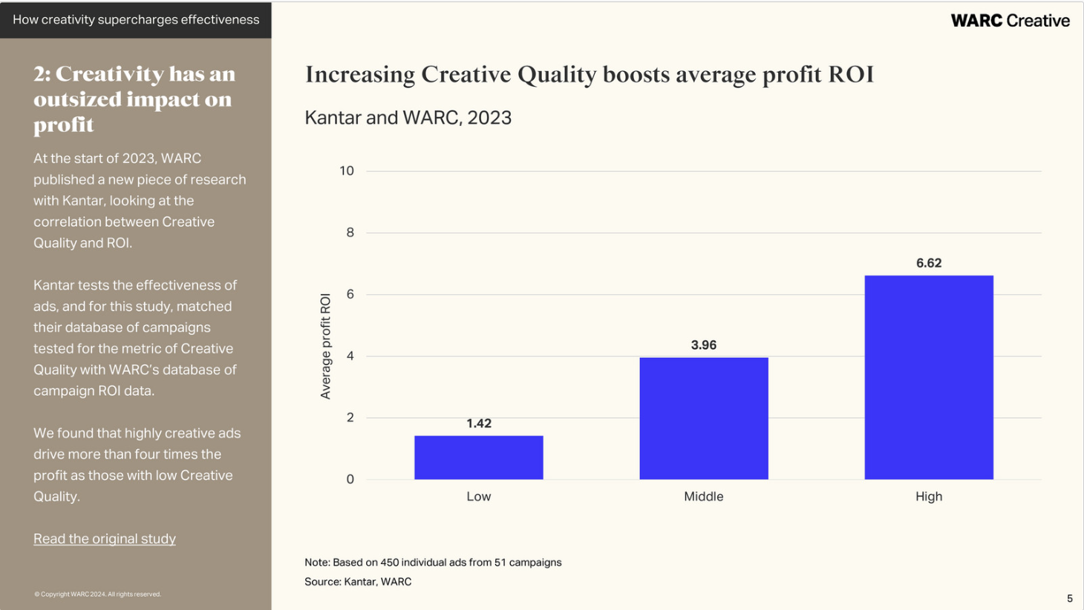
Notes:
From 1990 to 2008 there has been a steady decline in creativity in the US, according to research conducted by Kyung Hee Kim at the College of William & Mary. While I couldn’t find any similar South African data, a Newsweek article from 2010 suggests that it may be an America only phenomena:
Around the world, though, other countries are making creativity development a national priority
I’m not sure I buy that view? As Kim points out in a paper in the Creativity Research Journal in 2011,
Countries such as China, Japan, Korea, and Taiwan have modeled their educational systems after the American education system because of America’s previous success in encouraging creativity in children
It seems to me that one could quite easily conclude that creativity growth prospects, around the world, aren’t looking very healthy at all. And for those of you who prefer pictures…
It’s wasn’t the pictures that scared me as much as the conclusions that Kim draws from her research (included analyzing almost 300,000 Torrance scores of children and adults)…
Thus, it can be concluded younger children’s ability to produce statistically infrequent, unique, and unusual ideas has significantly decreased after 1990.
and….
The significant decrease of Strengths scores since 1990 indicates that over the last 20 years, children have become less emotionally expressive, less energetic, less talkative and verbally expressive, less humorous, less imaginative, less unconventional, less lively and passionate, less perceptive, less apt to connect seemingly irrelevant things, less synthesizing, and less likely to see things from a different angle. It could be speculated children are learning to interact in more impersonal ways, as they are more dependent on current technologies to communicate, perhaps because these technologies lack person to person, verbal and other interpersonal communicative signals. Technologies can enhance creativity and are useful tools for the creative process; however, some aspects of technologies may hinder the development of a child’s creative personality. The decrease in Elaboration scores which persists since 1984 indicates that over the last 30 years, 1) people of all ages, kindergartners through adults, have been steadily losing their ability to elaborate upon ideas and detailed and reflective thinking; 2) people are less motivated to be creative; and 3) creativity is less encouraged by home, school, and society overall.
and….
The results indicate younger children are becoming less capable of the critical thinking processes of synthesis and organization and less capable of capturing the essence of problems.
and….
The results indicate younger children are tending to grow up more narrow-minded, less intellectually curious, and less open to new experiences.
I don’t know about you, but it’s at this point I’m hoping like hell that this is just an American problem. My gut, sadly, tells me otherwise. While I don’t have any data, my own anecdotal observations quite easily match some of these conclusions in the world I inhabit. I’d be more than happy to be proved incorrect.
Does It Matter?
Of course it matters. At a macroeconomic level it counts.The health of an economy relies heavily on the creativity and innovation of scientists, engineers, business people, farmers, miners, and any person who contributes towards it, to employ more people, build more things that other countries want to buy, produce more food from the same piece of land, improve our national health, secure our borders, etc, etc. And we have to do it better than before. We can’t just do what we did last year, and the year before. We’ve got to find new and improved ways to do everything, all the time. Cheaper, better, faster and more of it.
On a microeconomic level you can take that thinking and run it through almost every single part of an economy. Provinces want all that, cities want it too, and so do businesses, and sports teams, and farmers and miners, and families and you. Even Mother Nature is hoping we’ll find better ways to treat our planet and everything that lives on it.
At a personal level it matters. Creativity breathes life into an otherwise mundane and boring existence. I don’t know if you’ve ever considered a life in which you had no access to creativity inside of yourself? A life without the skill set of creativity leaves you doing what when you get home from a day in the office where you followed instructions all day? It leaves you doing what on the weekend when you wake up on Saturday morning yearning to do something different? Well actually there’ll be no yearning. Creativity is that yearning to do something different, something unusual, something adventurous.
Here Come The Machines
I’ve always held onto the view that the one thing machines / robots will never do better than humans is ‘creativity’. When it comes to repetitive functional tasks they’re already replacing us and showing they do those jobs far better. But creativity, I don’t think so. That’s our domain. It’s what makes us human. The ability to not only desire to find another way, but to also take disconnected bits and pieces, and thoughts and ideas and put them together in a way that changes the world. I often say to my peer group of parents, don’t let your children study anything a machine might be able to replace, because a machine will replace it. Encourage your children to pick something, anything, that has an element of creativity at it’s centre and they’ll never have to complete with a machine or a robot. Not ever.
But if we’re going to let our creativity levels slide into the toilet, it’s not going to be a case of machines catching up to our creativity level, we’re just gonna hand it over to them on a plate, as we slide on by, towards a world of grey (no shades, just grey).
The Magic That Is Creativity
We’ve become so fixated on getting smarter in our heads, that we’ve missed the magic that is creativity. Do any Google search on ‘Einstein quotes’ (I’ll make it easy for you) and you’ll see him speaking of imagination and creativity over and over again. Academic genius without creativity and imagination is nothing. It’s a machine. It’s a robot. Robots have that kind of smarts. They know lots of things in one dimension. They can apply those things in that one dimension faster than any human. Creativity and imagination unlock the potential of knowledge, because if you can’t apply knowledge it’s not worth having.
It was at 16, while Einstein was imagining what it would be like to ride next to a beam of light that the first thoughts of what was to become the Theory of Relativity was born. He was imagining long before he had the brainpower to solve the question he was asking.
I can’t say if this slide in creativity is happening here in South Africa or not? I can say, that if it is we need to do more than just pay attention. We need to stop the slide, turn it around and send it on it’s way into space where our children, all of them, have imagination power to think about things like riding next to light beams, and then we can be assured that all this academic information we’re feeding them will be put to great use, and maybe even change the world.

Slide 56
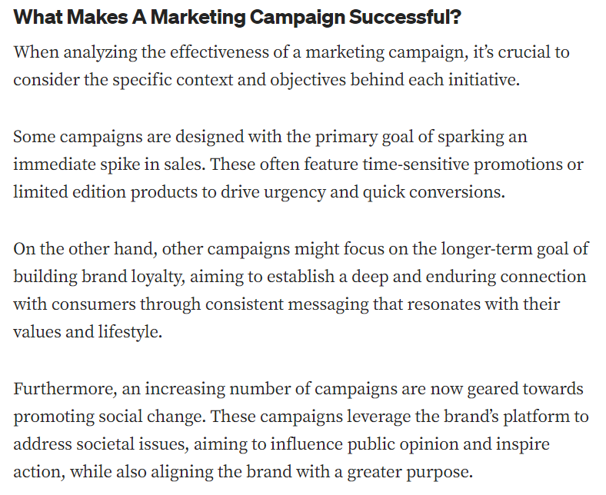
Notes:
https://medium.com/@dplayer/10-most-effective-marketing-campaigns-of-all-time-and-why-ece4ab23f1cc

Slide 57
Opgave
Find én reklamefilm, som I mener er god.
Hvorfor er den god?
Skriv en liste over ting der gør den god.
10 min. til at finde reklamen
10 min. til at lave listen

Slide 58
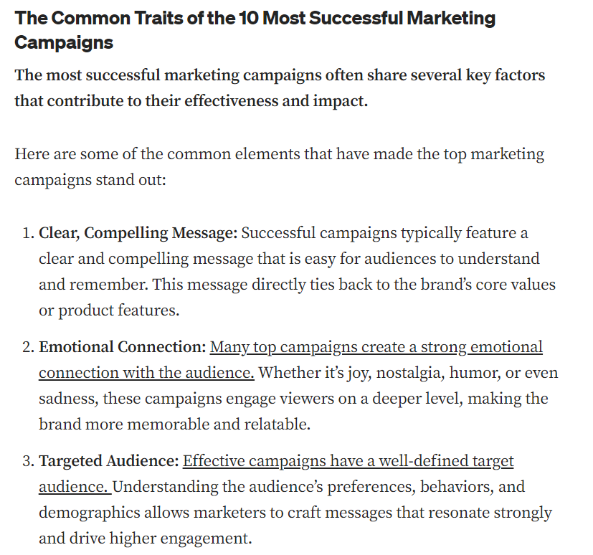
Notes:
https://medium.com/@dplayer/10-most-effective-marketing-campaigns-of-all-time-and-why-ece4ab23f1cc

Slide 59
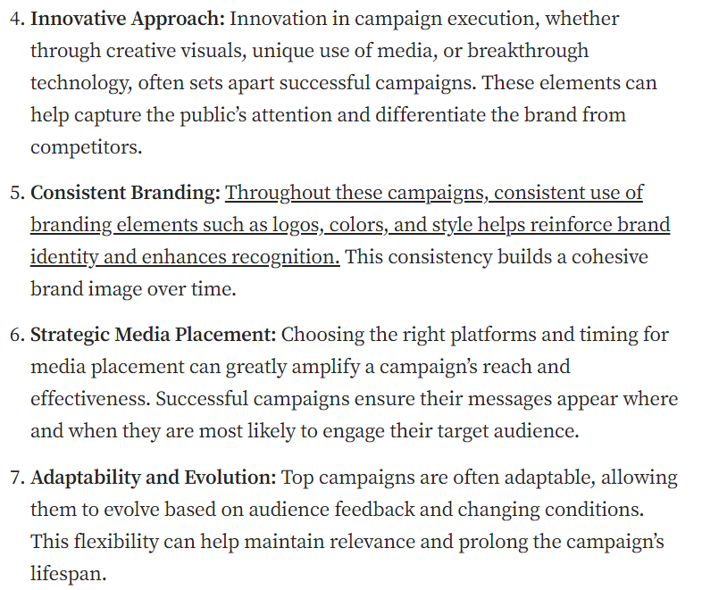
Notes:
https://medium.com/@dplayer/10-most-effective-marketing-campaigns-of-all-time-and-why-ece4ab23f1cc

Slide 60
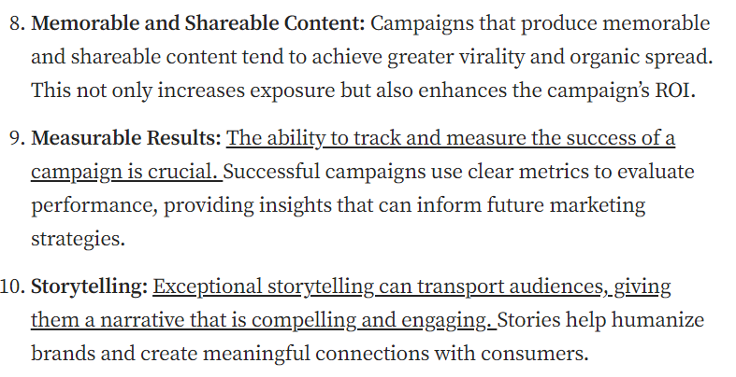
Notes:
https://medium.com/@dplayer/10-most-effective-marketing-campaigns-of-all-time-and-why-ece4ab23f1cc

Slide 63
Assignment for next time:
Groups: Adjust groups (inform Flemming)
Assign responsibilities – Q1, Q2, Q3, C1. You need some serious project management skills!
Portfolio: Start making portfolio.
Literature list: Start your literature list.
Question 1: What is creativity/creative marketing? Presentation (week 41). Approx. 15 min. Must have link to presentation in portfolio.

Slide 64
